Slide 1

FINAL PROJECT
The Growia Shop Website Testing
Tester : Muhammad Chairil Aqza Ibrahim

Slide 2

Background
This Project, conducted as a part of the final project for the Software Quality Assurance training course, the project is about conducted testing at the Growia Shop website, which serves as an e-commerce that was initially built as a showcase for the products. Which already had the following features :
Login Features (For User / Buyer)
Sign-up Features (For User / Buyer)
Home page Features (Main Page)
Product Detail Features
And with the increasing demand for online purchasing, Growia Shop introduced a new business process and new features to develop. The features are :
User / Buyer Profil Management Features (Managing address and orders)
Shopping Cart Features
Checkout Features
Admin Features (For managing product stock and model)
M.C Aqza Ibrahim

Slide 3
Objective
The main objective of the tester for this project is to evaluate the quality, functionality and reliability of the Growia Shop website by performing manual testing which consist of multiple test case executions and defect reporting using multiple platforms (e.g : ms.excel and JIRA) to ensure the website works as the requirement document states.
The focus of testing activities is narrowed to the features that are currently in development status, which were already mentioned in the background.
Tester also conduct several exploratory tests to find defects/bugs that may also have a significant negative impact on the website.
M.C Aqza Ibrahim

Slide 4
Test SUMMARY
Test Type and Test Level
Test Type : Functional Test
Test Level : Component Integration Test, System Test and System Integration Test
Test Cases
Total Created : 48 test cases
Total Executed : 48 test cases
Defects
Total of defects Found : 26 defects
M.C Aqza Ibrahim

Slide 5
SAMPLE TEST CASE
Below is a sample of test case :
Test Case ID: CHECKOUT_047
Scenario Type: Negative
Test Type: Functional
Test Description: Verify that user cannot proceed to checkout with an empty cart
Pre Condition: User already on shopping cart page
Test Steps:
On the shopping cart, make sure there is no product selected / deleted all product
Click checkout
Expected Result: Checkout should be disabled or blocked if the cart is empty, with a warning or prompt to add items first.
Actual Result: User is redirected to the checkout page even when the cart is empty.
M.C Aqza Ibrahim

Slide 6
DEFECT REPORTING
Highest Severity & Priority
Title : Order did not success using credit card as payment method, and no pop-up appears at checkout page
Severity : Critical
Priority : High
Lowest Severity & Highest Priority
Title : Missing website logo in top of the main page
Severity : UI/UX
Priority : High
Highest Severity & Lowest Priority
Title : "Beli Sekarang" Button at main page is not working
Severity : Major
Priority : Medium
M.C Aqza Ibrahim

Slide 7
Conclusions
As for the conclusion, the tester concludes the following main points :
Manual testing conducted by the tester uncovered several important defects affecting the following features: the shopping cart, checkout, admin stock management, and a few UI elements.
Functional testing coverage was comprehensive across the shopping cart and checkout features. Proven that of 48 test cases that created 35 (73%) were created for those particular features.
Test execution matched the planned test cases. From a total of 48 test cases, the tester carried out 48 test cases (100% Completion rate) with 30 Tests Passed and 18 Tests Failed
Total Defects Found is 26. Defects that were found and relate to the test cases are 18 out of 26 (69%) defects, and defects that were found by exploratory testing are 10 out of 26 (31%) defects.
Defect severity and priority were analyzed to help determine which issues to prioritize and fix first. From a total of 26 defects, 10 of them are high priority, 8 of them are medium priority, and 8 are low priority. As for severity levels, there are 1 Critical, 11 Major, 12 Minor, and 2 UI/UX (Cosmetic).
M.C Aqza Ibrahim

Slide 8
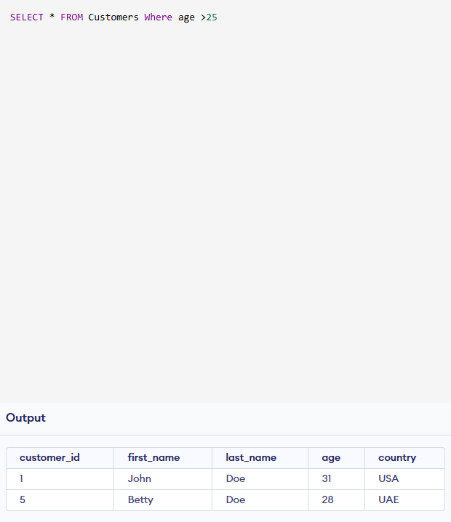
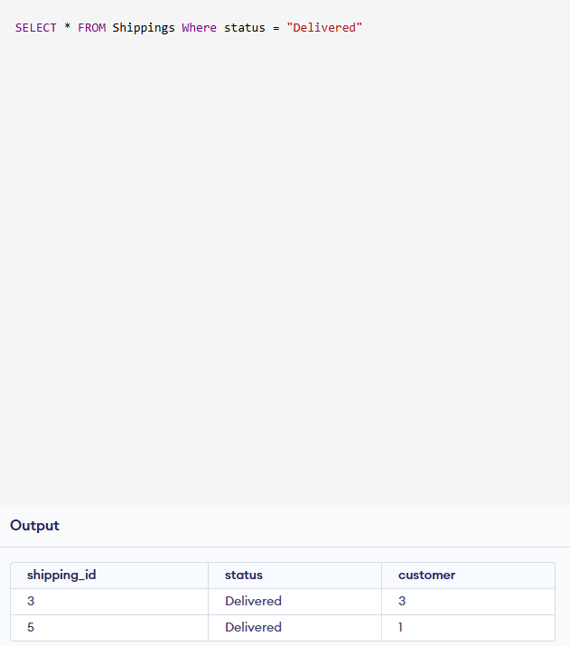
SQL TEST 1
1.
2.
M.C Aqza Ibrahim

Slide 9
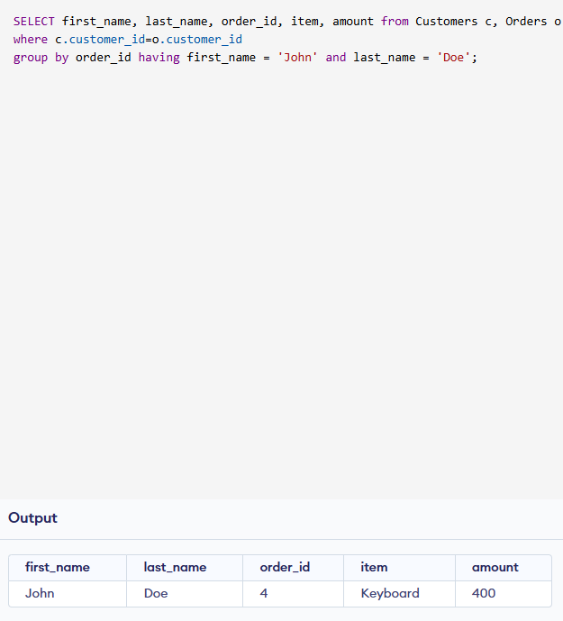
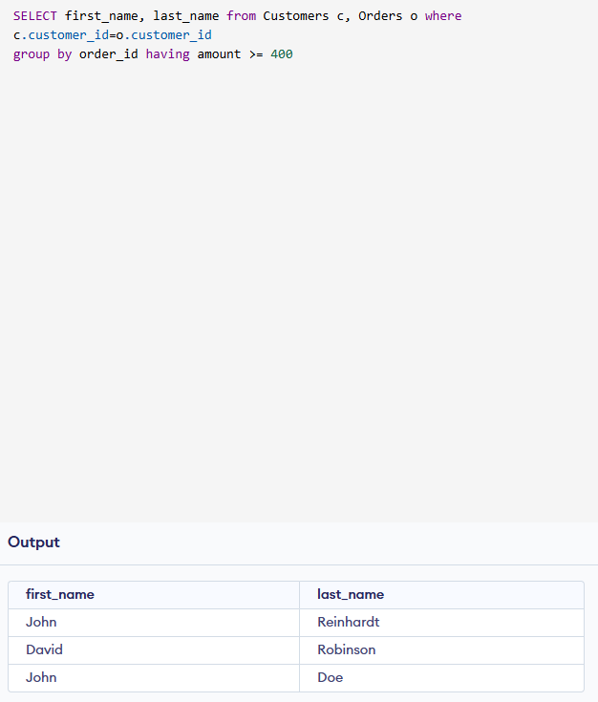
SQL TEST 2
3.
4.
M.C Aqza Ibrahim

